Slide 1


PROJECT NAME
CAPTION/MOTTO
#timetravellers
Akanksha Bhadauria
Vartika Gupta
Palak Goel
Soumya Baheti
Mili Singh
HackOFiesta-Flagship Hackathon of India
01

Slide 2
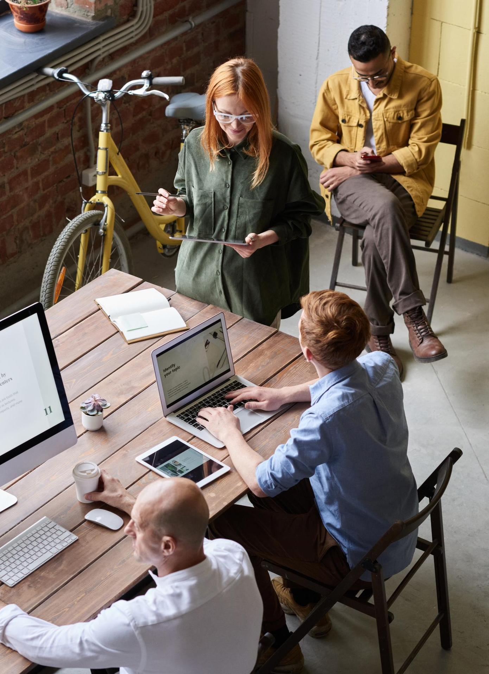

PROBLEM STATEMENT
ANY RELEVANT GRAPHIC
Alexa by using python .

Slide 3

PROPOSED SOLUTION
We are using amazon alexa so then, I decided to make my own alexa by using the world’s best language python.
By using the modules and packages of python I make this project.

Slide 4
Features of Alexa
Alexa is capable of voice interaction, music playback, making to-do lists, setting alarms, streaming podcasts, playing audiobooks, and providing weather, traffic, sports, and other real-time information, such as news.
Digital voice assistant, and is becoming an ever-present AI helper in our homes.

Slide 5

YOUR TECH STACK
This project is basically made by using python development. In this project is used various modules and packages of python.

Slide 6

THANK YOU
Feel free to add more slides!

